Slide 1
IE 362 Lecture 11: Sorting
Il-Chul Moon
Department of Industrial and Systems Engineering
KAIST

Slide 2
Short recap

Slide 3
O(N²) Sorting
Sorting algorithm
Worst case O(N²) sorting
Without a divide-and-conquer approach
Sequential comparisons with two index iterations
Usually there is a nested loop that ranges
Outer loop: from the first to the end
Inner loop:
from the outer loop’s index to the end
Or, from the first to the outer loop’s index
Variants
Insertion Sort
Selection Sort
Bubble Sort
Pros and Cons?
Cons: time complexity
Pros?
Easy to implement

Slide 4
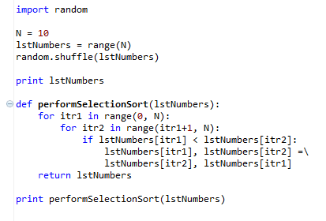
Selection sort algorithm
Examples of algorithms
Insertion, deletion, search of linked lists, stacks, queues…
Sorting of linked lists…
Various sorting methods
Bubble sort, Quick sort, Merge sort…
Selection Sort(list)
For itr1=0 to length(list)
For itr2=0 to length(list)
If list[itr1] < list[itr2]
Swap list[itr1], list[itr2]
Return list
This program uses
Data structure: List
Algorithm: Selection sort

Slide 5
O(NlogN) Sorting
Sorting algorithm
Worst case O(N²) or O(NlogN) sorting
Average case O(NlogN) sorting
With a divide-and-conquer approach
Divide the target sequence into multiple sequences
Recursively perform sorting of the sub-sequences
Problem is
How to divide
Variants
Quick Sort
Heap Sort
Merge Sort
Pros and Cons?
Cons: bad division leads into O(N²) time complexity
Pros: relatively good time complexity

Slide 6
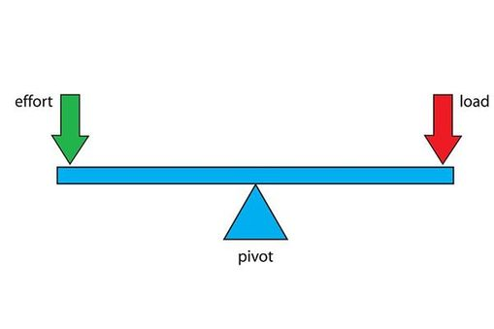
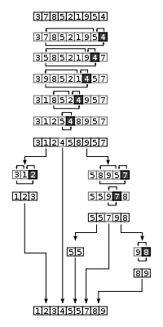
Quick sort
Basic idea
QuickSort(Sequence)
Given a sequence
Select a pivot
Pivot = a threshold to divide the sequence into two sub-sequences
Divide the sequence into two sub-sequences
Sequence with values less than the pivot
Sequence with values greater than the pivot
Return
QuickSort(sequence with less) + Pivot + QuickSort(sequence with greater)
Merge sort forces to divide the sequence in the middle
Always the similar size of the sub-sequence
This divides the sequence with the pivot selection

Slide 7
Importance of pivot in quick sort
3 | 7 | 8 | 5 | 2 | 1 | 9 | 5 | 4
1 | 3 | 7 | 8 | 5 | 2 | 9 | 5 | 4
1 | 2 | 3 | 7 | 8 | 5 | 9 | 5 | 4
1 | 2 | 3 | 7 | 8 | 5 | 9 | 5 | 4
1 | 2 | 3 | 4 | 7 | 8 | 5 | 9 | 5
1 | 2 | 3 | 4 | 5 | 7 | 8 | 9 | 5
1 | 2 | 3 | 4 | 5 | 5 | 7 | 8 | 9
1 | 2 | 3 | 4 | 5 | 5 | 7 | 8 | 9
1 | 2 | 3 | 4 | 5 | 5 | 7 | 8 | 9
1 | 2 | 3 | 4 | 5 | 5 | 7 | 8 | 9
8 comparisons
What-if the pivot is biased
Let’s assume that
Pivot is always the smallest number
Then?
Just another selection sort
Same to the O(N²) sorting algorithms
Hence the pivot selection is important
Pivot selection approach
Median
Random
Practically, merge sort is more preferable because?
Doesn’t have to worry about the pivot selection
Worst case pivot selection

Slide 8
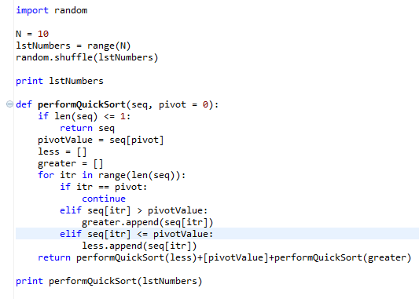
Implementation of quick sort
Random number generation
Pivot selection: always pick the first element
Dividing the sequence into two pieces
Recursive calls

Slide 9
O(N) Sorting
Sorting algorithm
Average case O(N) sorting
Not comparison-based approach
The best performance of the comparison based approach is O(NlogN)
Therefore, should not be based upon comparisons
Rather based upon counting and numeric properties
Variants
Radix Sort
Count Sort
Pros and Cons?
Cons: assumptions and not comparison-based
Pros: best time complexity

Slide 10
Counting Sort
Assumption
The sequence contains integers ranging from 0 to K
Count the occurrence and produce a sequence based upon the counts
Basic idea
For itr from 0 to N
Value = sequence[itr]
Count[value] = Count[value] + 1
For itr1 from 0 to K
For itr2 from 0 to Count[itr1]
Print itr1
Time complexity
O(N+R)
R = the range of the sequence values
N = the size of the sequence
3 | 7 | 8 | 5 | 2 | 1 | 9 | 5 | 4
1 occurrence of 1
1 occurrence of 2
1 occurrence of 3
1 occurrence of 4
2 occurrences of 5
1 occurrences of 7
1 occurrences of 8
1 occurrences of 9
1 | 2 | 3 | 4 | 5 | 5 | 7 | 8 | 9

Slide 11
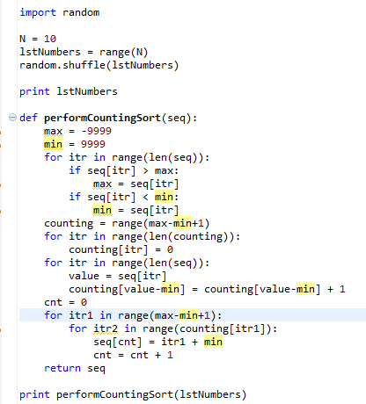
Implementation of counting sort
Random number generation
Preparing the counting space
Perform counting
Print the counted numbers

Slide 12
Offline class plan

Slide 13
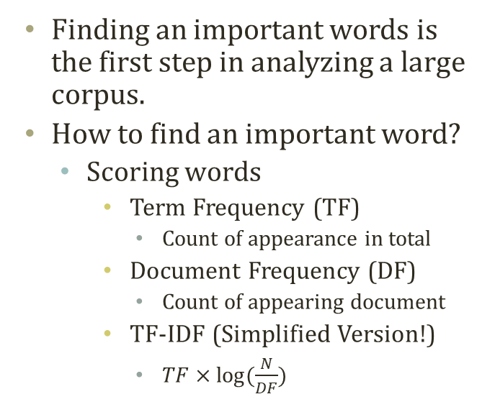
Text Analysis with Keywords
Finding an important words is the first step in analyzing a large corpus.
How to find an important word?
Scoring words
Term Frequency (TF)
Count of appearance in total
Document Frequency (DF)
Count of appearing document
TF-IDF (Simplified Version!)
$TF×log⁡(\frac{N}{DF})$
Num | TF_Words | TF_Values | DF_Words | DF_Values | TFIDF_ Words | TFIDF_ Values
0 | the | 2150 | Path: | 100 | # | 491.2209
1 | to | 1233 | From: | 100 | . | 370.8236
2 | of | 1109 | Newsgroups: | 100 | MR. | 299.3361
3 | and | 875 | Subject: | 100 | STEPHANOPOULOS: | 299.3361
4 | a | 678 | Message-ID: | 100 | Q | 255.9787
5 | that | 632 | Date: | 100 | > | 227.5664
6 | in | 585 | Lines: | 100 | Rockefeller | 202.6275
7 | is | 525 | Apr | 99 | South | 196.7852
8 | I | 373 | Organization: | 95 | ] | 191.6891
9 | for | 372 | of | 94 | is | 179.8074
10 | > | 348 | to | 94 | was | 176.9108
11 | are | 344 | the | 94 | secret | 173.7525
12 | you | 286 | GMT | 92 | in | 168.294
13 | be | 275 | a | 88 | naval | 161.181
14 | not | 262 | and | 87 | been | 151.2872
15 | on | 259 | References: | 85 | The | 149.1964
16 | it | 254 | Re: | 80 | Georgia | 148.6569
17 | as | 253 | that | 80 | war | 147.2754
18 | was | 248 | In | 76 | military | 143.7689
19 | with | 244 | in | 75 | that | 141.0267
A,B,B,B,C….
B,C,D….
A,C,….
B’s TF = 4,
B’s DF = 2,
B’s TF-IDF = 4*log(3/2)

Slide 14
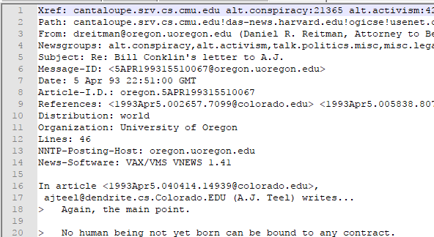
20 Newsgroup
20 Newsgroup is a text dataset collecting news articles and responses on various subjects.
Very popular text-mining benchmark dataset
Original raw text requires parsing
BagOfWordCreator.py
Does the parsing for you
Calculate the bag-of-word for you
self.words
['Xref:', 'cantaloupe.srv.cs.cmu.edu', 'alt.news-media:739', 'alt.politics.elections:6015', 'talk.politics.misc:124146', ………..
self.bows
{0: 1, 1: 1, 9882: 1, 9883: 1, 9884: 1, 9885: 1, 5: 1, 9886: 1, 7: 1, 5748: 1, 5567: 2, ………………

Slide 15
To-Do : Code Completion and Exp.
You need to complete the codes in ‘TFIDFAnalyzer.py’ and ‘SortingAlgorithm.py’
Complete the score calculation of TF, DF, and TF-IDF
Complete the quick sorting algorithm
To-do 1) complete ‘calculateTermFrequency’ in ‘TFIDFAnalyzer’
You need to use self.bows and self.words
To-do 2) complete ‘calculateDocumentFrequency’ in ‘TFIDFAnalyzer’
You need to use self.bows and self.words
To-do 3) complete ‘calculateTFIDF’ in ‘TFIDFAnalyzer’
You need to use the two methods that you just coded
To-do 4) complete ‘performSorting’ of ‘QuickSort’ in ‘SortingAlgorithm’
Descending-order sorting
Return keys and values
Keys : words – attachment to values
Values : scores – target for sorting
Exp 1) experiment the speed with the selection sorting and the quick sorting

Slide 16
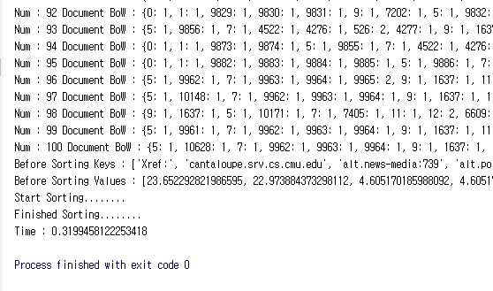
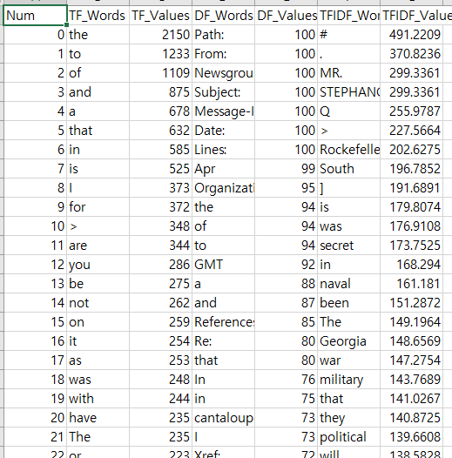
Expected Result
Execute ‘TFIDFAnalyzer.py’
Open ‘ImportantTerms.csv’ with Excel

